Slide 1

CS483 Digital Forensics
Windows Internals I

Slide 2
Lesson Learning Objectives
Understand the overall architecture of the Windows OS
Describe a process and the process address space
Discuss various Windows data structures and program control flow

Slide 3
Windows API (Win32 API)
The Win32 API is used to interface with the Windows OS
DLLs (Dynamic Link Libraries) export the API to user programs
Layers of abstraction
User API (e.g., CreateFileW)
Native API (e.g., NtCreateFile)

Slide 4
Windows API Data Types
Windows | C/C++ Managed Type | Description
VOID | void | Applied to a function that does not return a value
HANDLE | void * | 32 bits on 32-bit Windows, 64 bits on 64-bit Windows
BYTE | unsigned char | 8 bits
SHORT | short | 16 bits
WORD | unsigned short | 16 bits
INT | int | 32 bits
UINT | unsigned int | 32 bits
LONG | long | 32 bits
DWORD | unsigned long | 32 bits
ULONG | unsigned long | 32 bits
CHAR | char | Decorate with ANSI
WCHAR | wchar_t | Decorate with Unicode
LPSTR | char * | Decorate with ANSI
LPCSTR | const char * | Decorate with ANSI
LPWSTR | wchar_t * | Decorate with Unicode
LPCWSTR | const wchar_t * | Decorate with Unicode

Slide 5
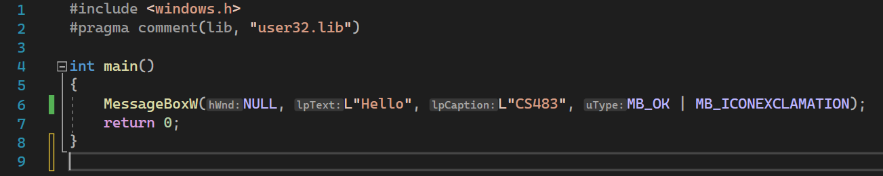
Simple Hello Program

Slide 6
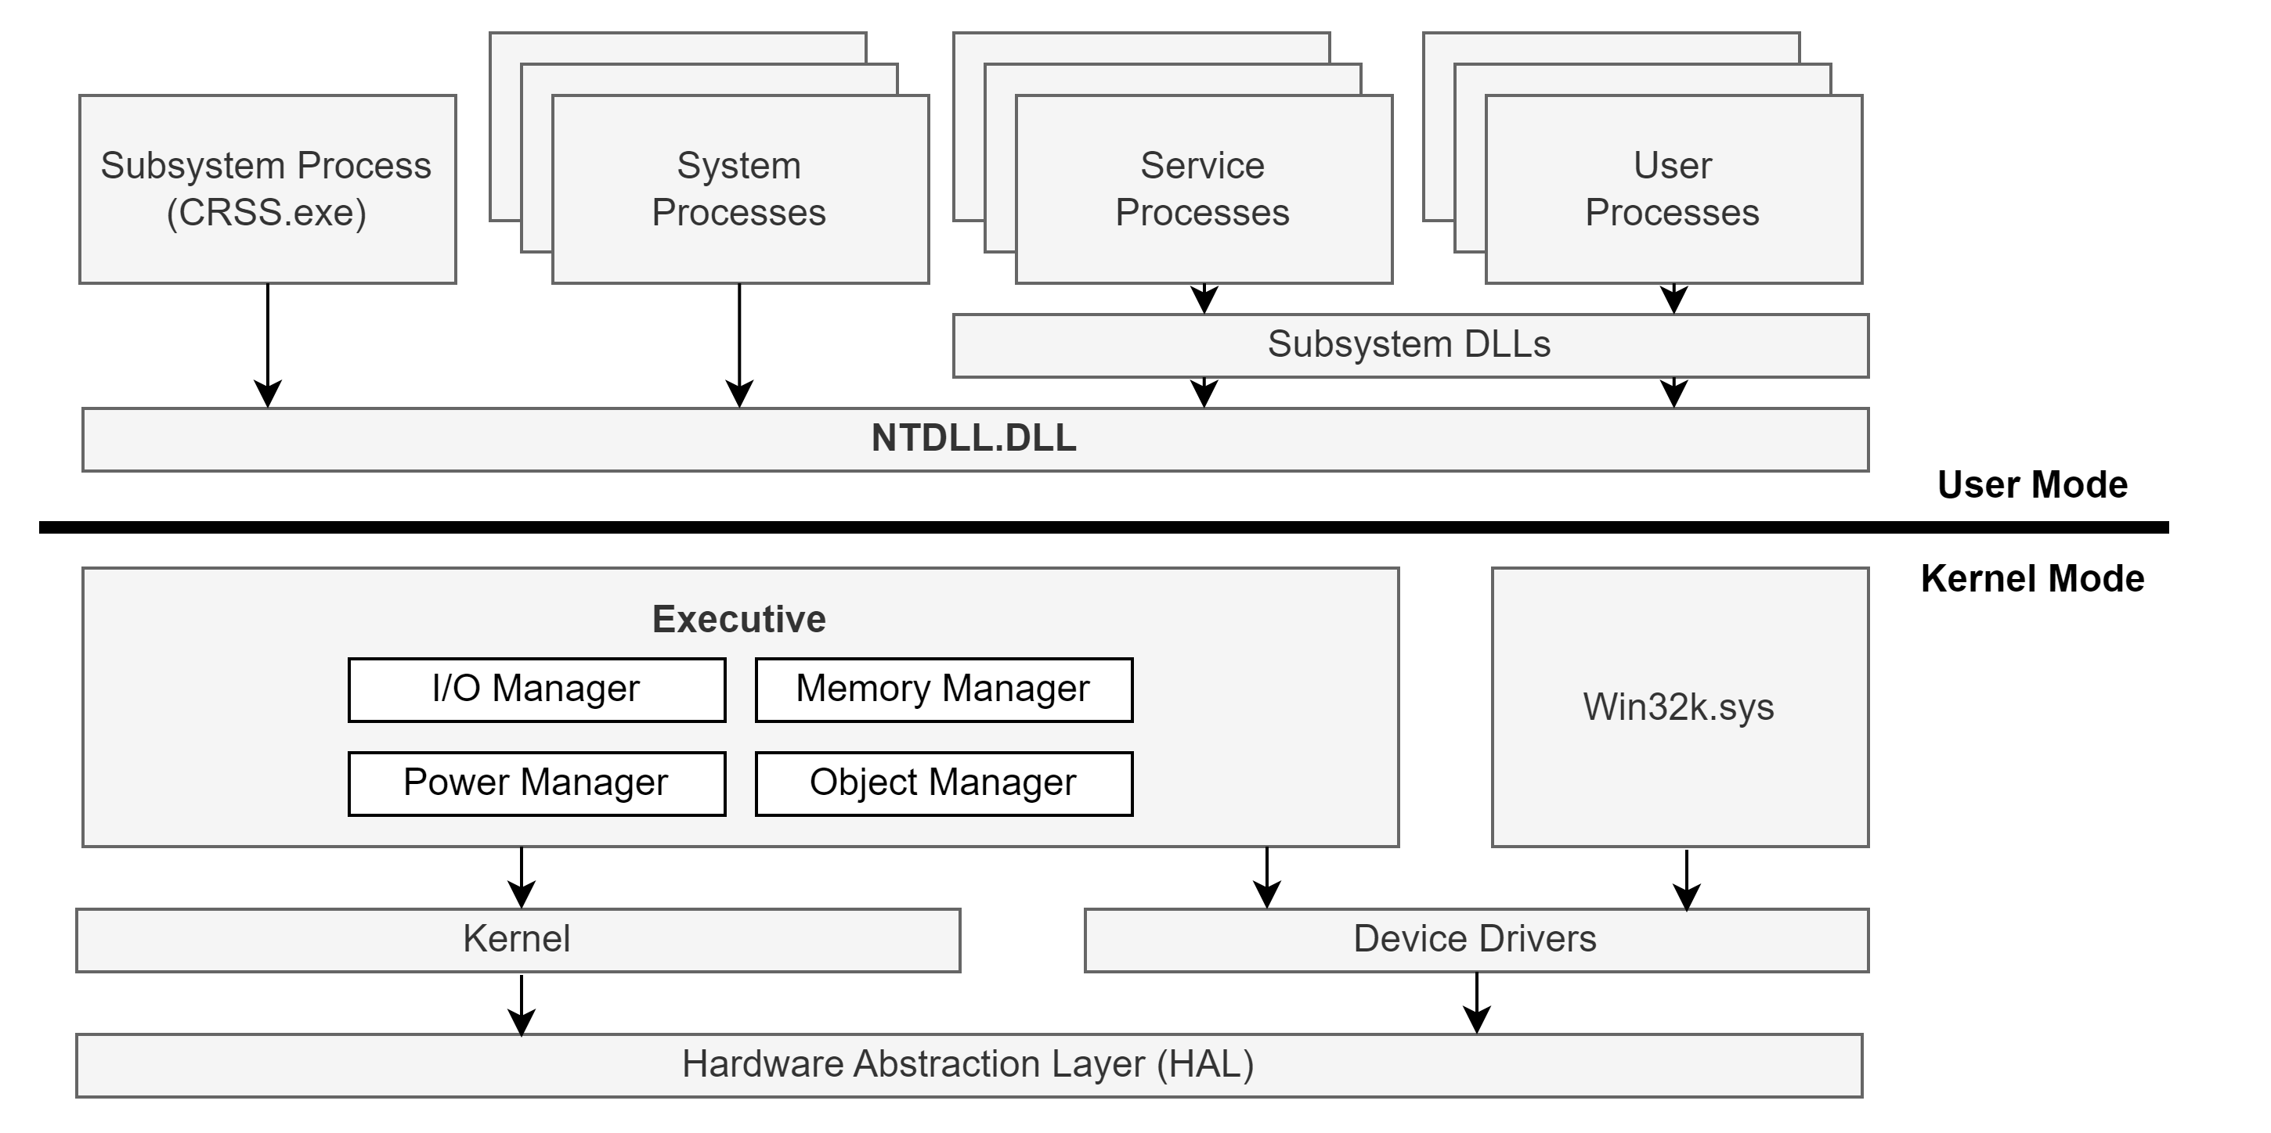
Windows Architecture Overview
Notes:
User Processes – Normal processes based on image files (PE32 exe files), such as notepad.exe, cmd.exe, explorer.exe, etc.
Subsystem DLLs – Dynamic Link Libraries (DLLs) that implement the API of a subsystem. A subsystem is a view of capabilities the OS exposes to processes. These DLLs, found in C:\Windows\System32, export the officially documented API of Windows (Win32 API)
NTDLL.DLL – Implements the Windows Native API. This is the lowest layer of code in user mode. It contains system call wrappers to transition into kernel mode (trap). It also implements the heap manager and the image loader.
Service Processes – Normal Windows processes that communicate with the Service Control Manager (SCM, implemented in services.exe).
System Processes – Umbrella term to describe Windows processes that are always just there. Examples include smss.exe, lsass.exe, winlogon.exe, services.exe, etc.
Subsystem Process (crss.exe) – Helper for the kernel to manage processes.
Executive – Upper layer of the kernel (NtOskrnl.exe). Hosts most of the kernel mode OS code. Contains various managers.
Kernel – Lower layer of NtOskrnl.exe. Implements the most fundamental and time-sensitive parts of the kernel mode OS. This include thread scheduling, interrupt and exception dispatching, and implements kernel primitive objects such as mutexes and semaphores.
Device Drivers – Loadable kernel modules.
Win32k.sys – Kernel module (driver) that handles the UI part of Windows
Hardware Abstraction Layer (HAL) – Abstraction layer over the hardware closest to the CPU. It allows device drivers to use APIs that do not require intimate knowledge of the hardware, such as interrupt controllers and DMA controllers

Slide 7
EXEs and DLLs
Dynamic Link Library (DLL)
Exposes the Windows API (Win32) to user programs and processes
Exports Win32 functions
Examples include user32.dll and kernel32.dll
Ntdll.dll is a special dll that transitions the exposed API into low level system calls
EXE
Executable image file that contains data and compiled code
Examples include notepad.exe, explorer.exe, cmd.exe
Both DLLs and EXEs adhere to the PE32 file structure
Notes:
We’ll cover the PE32 file structure in more depth in future lessons

Slide 8
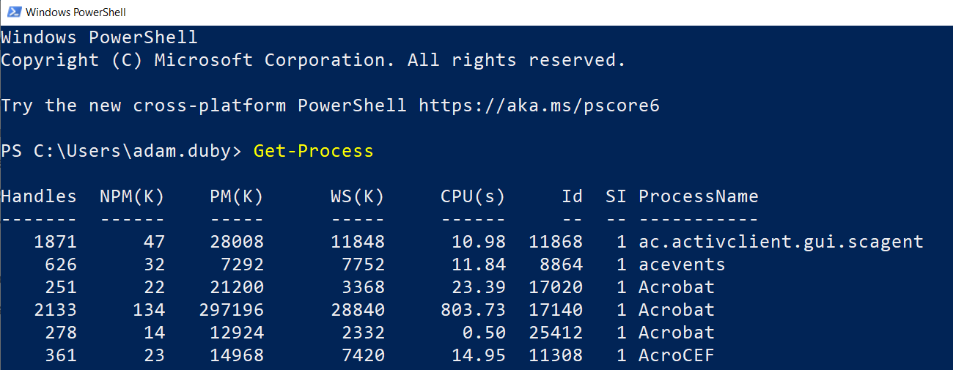
Processes
A process is a program in execution
Process Object – Containment and management object that represents a running instance of a program
A process is uniquely identified by its Process ID (PID)

Slide 9
Each Process Owns:
An executable program
A private virtual address space (process address space)
A primary token – An object that stores the default security context of the process
A private handle table to executive objects
One or more threads

Slide 10
Virtual Memory – Process Address Space
Every process has its own virtual, private, linear address space
Process address space size varies with respect to the process bitness
Process Bitness | OS Bitness | LARGEADDRESSAWARE Flag | Process Address Space
32-bit | 32-bit | OFF | 2 GB
32-bit | 32-bit | ON | Up to 3 GB
32-bit | 64-bit | OFF | 2 GB
32-bit | 64-bit | ON | 4 GB
64-bit | 64-bit | N/A | 8 TB (< Win 8); 128 TB (> Win 8.1)
Notes:
The address space starts out mostly empty. The executable image (e.g. PE32 file) and ntdll.dll are the first to be mapped, followed by more subsystem DLLs. Private means other processes cannot access it directly. Address space starts at 0 (although the first 64KB of address cannot be allocated or used in any way), and goes up to a max which depends on the process “bitness” (32-bit or 64-bit).

Slide 11
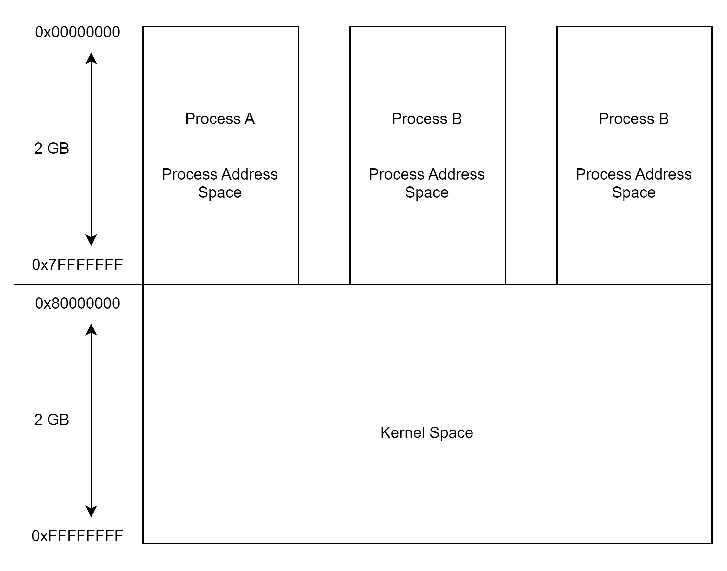
32-Bit Memory w/ 4GB Virtual Memory
Notes:
In traditional 32-bit models w/ 4GB of virtual memory, the MSB (most significant bit) indicates user space or kernel space
Process addresses are process-relative. To reference a memory address less than 0x7FFFFFFF, the OS also needs to know which process.

Slide 12
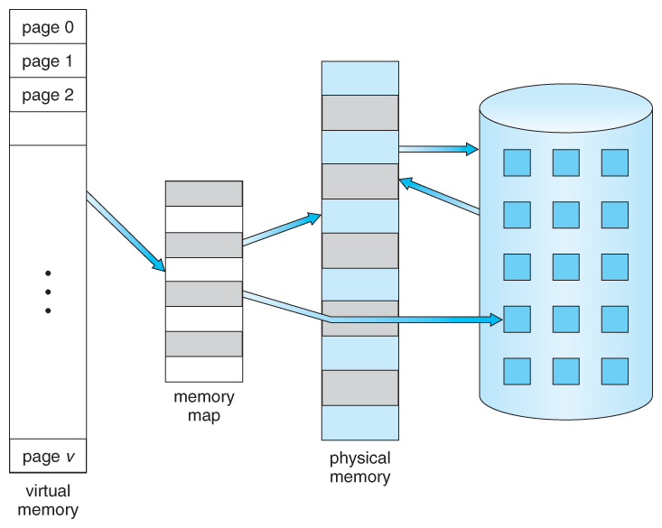
Virtual Memory – Process Address Space
Unit of memory management is a page
Typical page size on Windows supported architectures is 4KB
Each page in virtual memory can be in one of three states:
Free – Not allocated
Committed – Mapped w/ protection attributes
Reserved – Not committed, but reserved for possible future commitment; From CPU’s perspective, same as free
Notes:
The memory is virtual – there is an indirect relationship between an address range and the exact location where it’s found in physical memory (RAM). A buffer in a process may be mapped to physical memory, or it may have been paged out and lives in a page file. If not mapped, the CPU raises a page fault exception that will cause the memory manager’s page fault handler to fetch data from the appropriate page file, copy it to RAM, and update the page table entries.

Slide 13
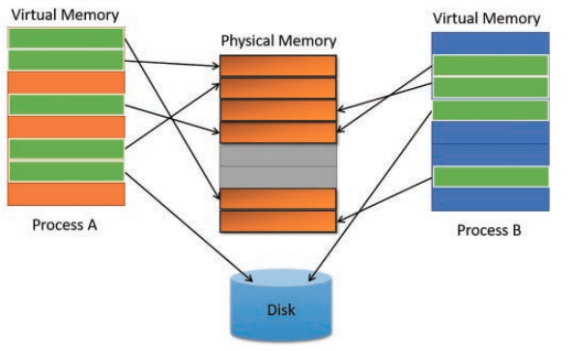
Virtual Memory – Process Address Space
Notes:
The physical memory (RAM) layout details is abstracted away from the process.

Slide 14
Kernel Space (System Space)
Not process-relative
Any address in system space is absolute
Looks the same from every process context
Access from user mode into system space results in an access violation exception
System space contains the actual kernel, the HAL, and kernel drivers

Slide 15
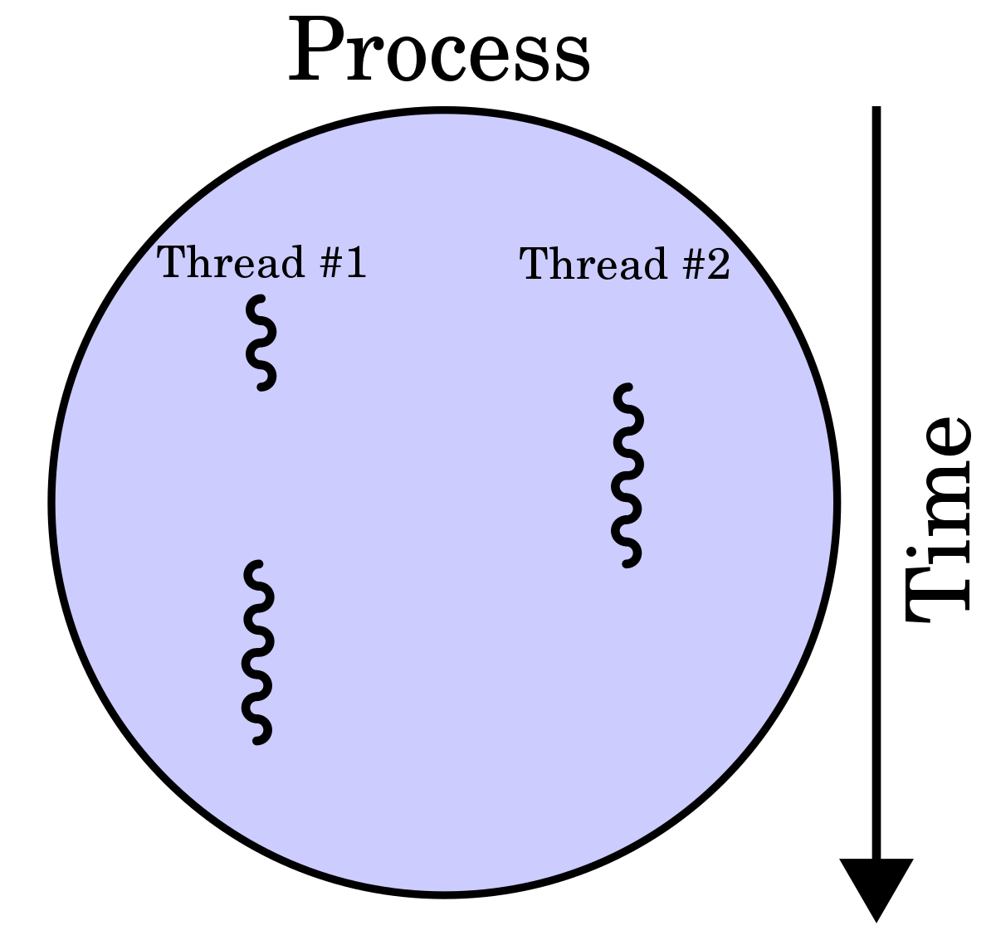
Threads
Threads are the actual entities that execute code
Processes are containers of 1 or more threads
A thread owns:
Current access mode (kernel or user)
Execution context (registers, execution state)
One or two stacks for local variables and call management
Thread Local Storage (TLS) array, which provides a way to store thread-private data
Priority
Processor affinity

Slide 16
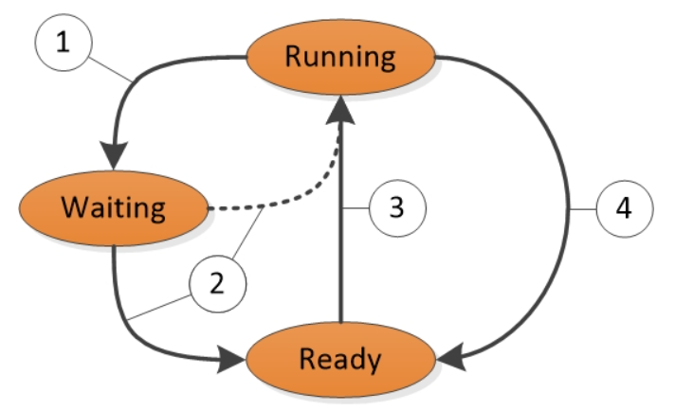
Thread States
State Transitions:
Blocking call
Processor is idle or priority causes a preemption
Thread is dispatched when current thread reaches the end of its quantum or is put into waiting state
Preempted by a higher priority thread
Notes:
Thread State Transitions is explained as follows:
A thread in the Running state initiates a transition to the Waiting state by calling a wait function such as WaitForSingleObject or Sleep(> 0).
A running thread or kernel operation readies a thread in the Waiting state (for example, SetEvent or timer expiration). If a processor is idle or if the readied thread has a higher priority than a currently running thread, the readied thread can switch directly to the Running state. Otherwise, it is put into the Ready state.
A thread in the Ready state is scheduled for processing by the dispatcher when a running thread waits, yields (Sleep(0)), or reaches the end of its quantum.
A thread in the Running state is switched out and placed into the Ready state by the dispatcher when it is preempted by a higher priority thread, yields (Sleep(0)), or when its quantum ends.
A thread that exists in the Waiting state does not necessarily indicate a performance problem. Most threads spend significant time in the Waiting state, which allows processors to enter idle states and save energy. Thread state becomes an important factor in performance only when a user is waiting for a thread to complete an operation.

Slide 17
Handles
The operating system exposes resources to user programs
In Windows, OS resources are known as executive objects (or kernel objects)
Examples:
Files, Mutexes, Semaphores
We don’t want user programs to directly access and manipulate kernel objects
Windows exposes objects through handles, which point indirectly to the kernel resource
Before a process can access a resource, it must first get a handle on the object

Slide 18
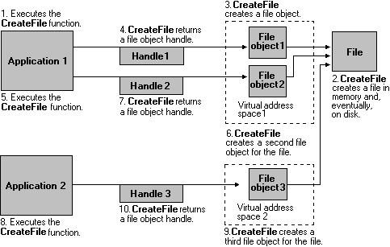
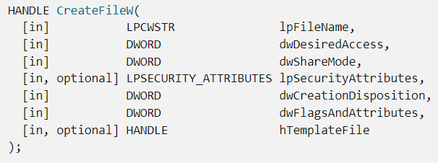
Handles

Slide 19
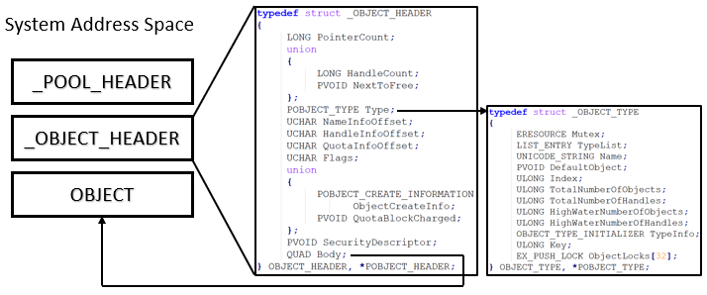
Kernel Objects

Slide 20
Getting a Handle on Things
Many Window API functions return a handle to the caller. This handle points indirectly to the kernel object
Handles are stored in the process handle table
Handles.exe
Process Hacker

Slide 21
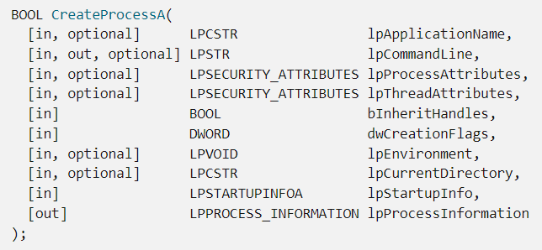
Inheritable Handles
If TRUE, each inheritable handle in the calling process is inherited by the new process.
If FALSE, the handles are not inherited. Inherited handles have the same value and access rights as the original handles.
Notes:
https://learn.microsoft.com/en-us/windows/win32/api/processthreadsapi/nf-processthreadsapi-createprocessa

Slide 22
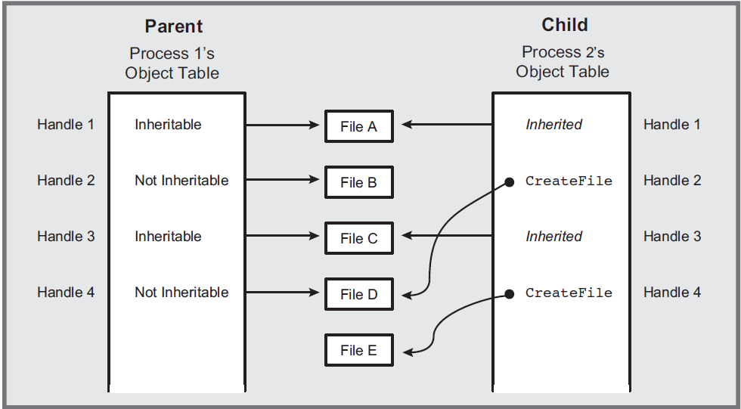
Inheritable Handles
Notes:
Parent process forked a child with bInheritHandles = TRUE. Only inheritable handles are inherited by the child process.

Slide 23
System Calls (System Services)
System services, such as allocating memory, opening files, and creating threads, must be performed in kernel mode code
Example. Consider a user process wants to create a file.
CreateFileW User API

Slide 24
System Call Example
The user process calls CreateFileW, which is imported from the DLL that exposes the function.
A sequence of trampolines and unwrapping is performed before the actual trap into kernel mode (the system call)

Slide 25
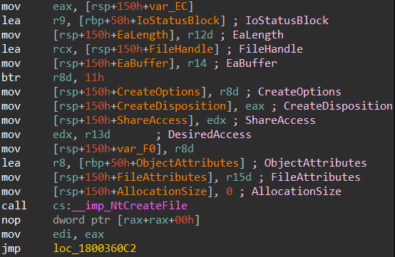
System Calls
System services, such as allocating memory, opening files, and creating threads, must be performed in kernel mode code
Example. Consider a user process wants to create a file.

Slide 26
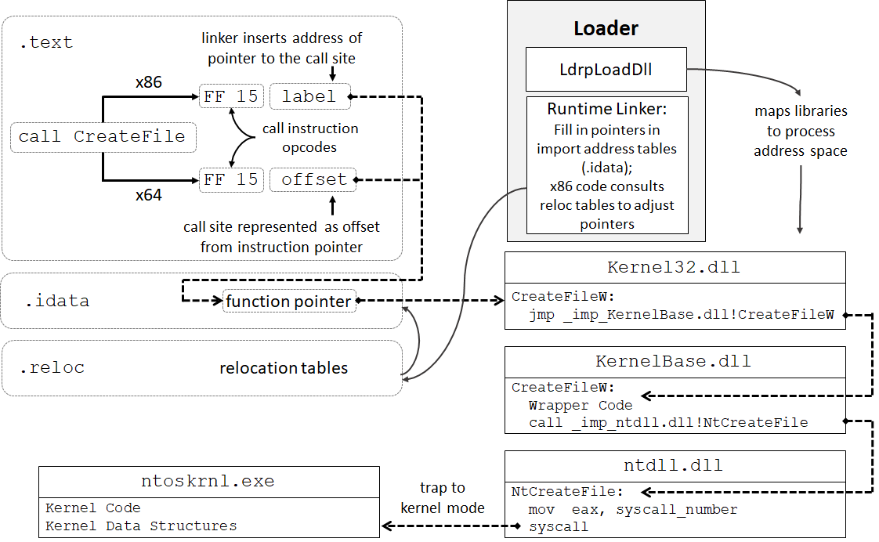
A Peak Inside ntdll.dll
Notes:
Walk through this in class

Slide 27
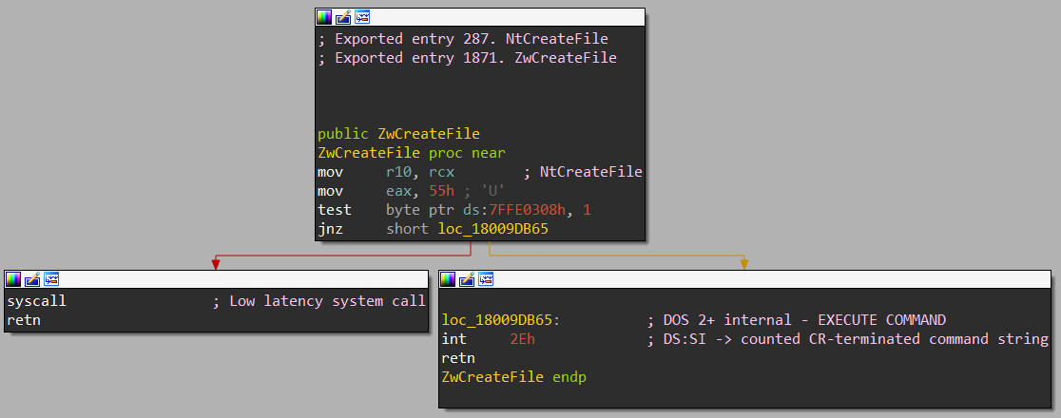
A Peak Inside ntdll.dll
From Windows 10 ntdll.dll
Notes:
The system call number (Dispatch ID) for NtCreateFile is 0x55.
The test at 0x7FFE0308 is checking for bitness. If x64, then syscall is invoked. Otherwise, a software interrupt (int 2E) is invoked.

Slide 28
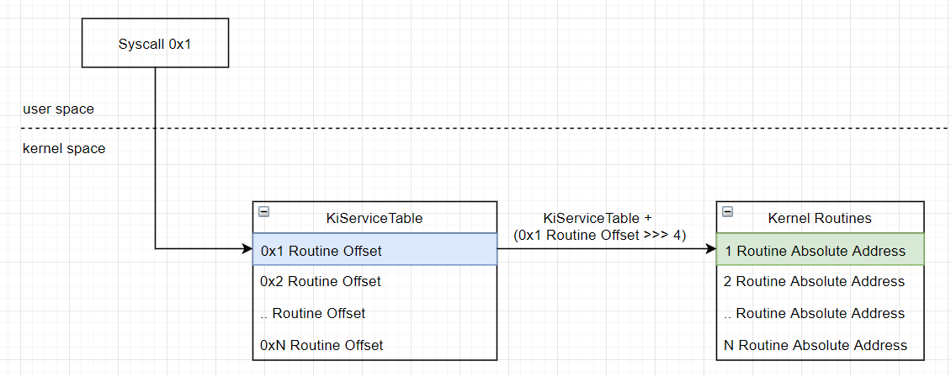
System Call Dispatching

Slide 29
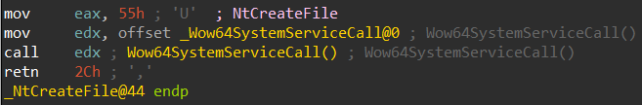

WOW (Windows on Windows)
WOW is an abstraction layer that lets 32-bit programs run on a 64-bit operating system
C:\Windows\SysWOW64
32-bit Windows subsystem
C:\Windows\System32
64-bit Windows subsystem
From Windows 10 C:\Windows\SysWOW64\ntdll.dll
Notes:
There are typically 2 versions of the entire Windows Subsystem on every Windows OS: a 32-bit variant, and the 64-bit variant. WOW is an abstraction layer that exposes a 32-bit view of a 64-bit system to 32-bit processes.
Heaven’s Gate.

Slide 30
Strings and Things
Each Windows API has multiple variants
CreateFileA
Expects ANSI strings in the arguments (1 byte per character)
CreateFileW
Expects Unicode strings in the arguments (2 bytes per character)
Behind the scenes, Windows does everything in Unicode
ANSI variants are wrappers around the Unicode versions
Modern best programming practice on Windows is to use Unicode for everything when possible

Slide 31
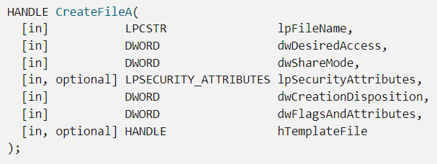

Strings and Things
CreateFileA requires string arguments to be of type LPCSTR (ANSI).
CreateFileW requires string arguments to be of type LPCWSTR (Unicode).

Slide 32
Summary
Understand the overall architecture of the Windows OS
Describe a process and the process address space
Discuss various Windows data structures and program control flow

Slide 33
Remember…
Everything is a data structure.
It’s all code. Not magic.
Abstraction leaves gaps.
Own your tools.

Slide 34
For Next Lesson
Review slides from this lesson and read ahead into the next lesson.
Experiment – On your VM, get comfortable with some of the tools and concepts we discussed.
Come prepared to program and dig deeper next lesson!

